Slide 1
PHYSICS 2 FLASH CARDS
Chapters 21-26

Slide 3

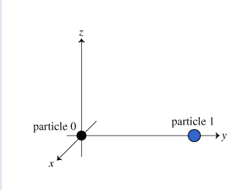

Slide 4


Slide 5

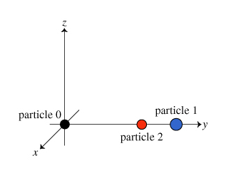

Slide 6


Slide 7


Slide 8


Slide 9

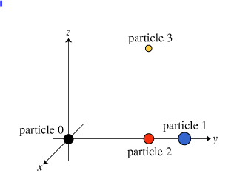

Slide 10


Slide 11

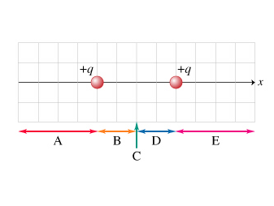

Slide 12


Slide 13

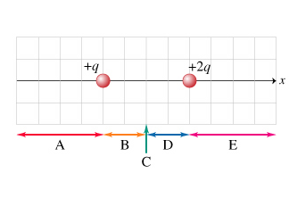

Slide 14


Slide 15

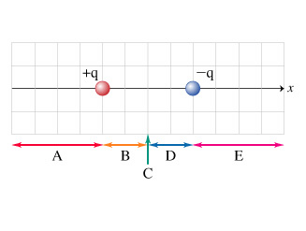

Slide 16


Slide 17
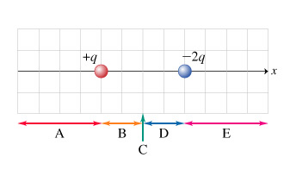

Slide 18
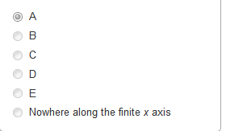

Slide 19
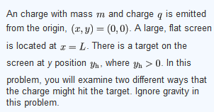


Slide 20


Slide 21


Slide 22


Slide 23
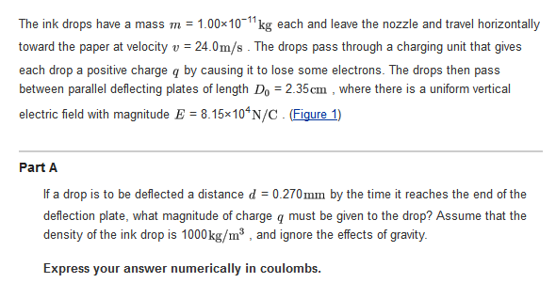

Slide 25
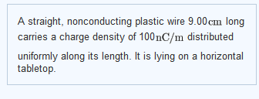

Slide 26


Slide 27


Slide 29
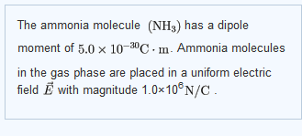


Slide 30


Slide 31


Slide 32


Slide 33
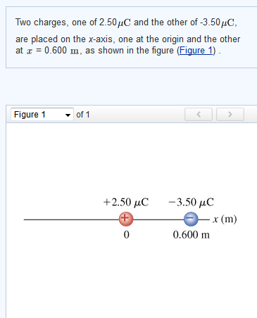

Slide 34
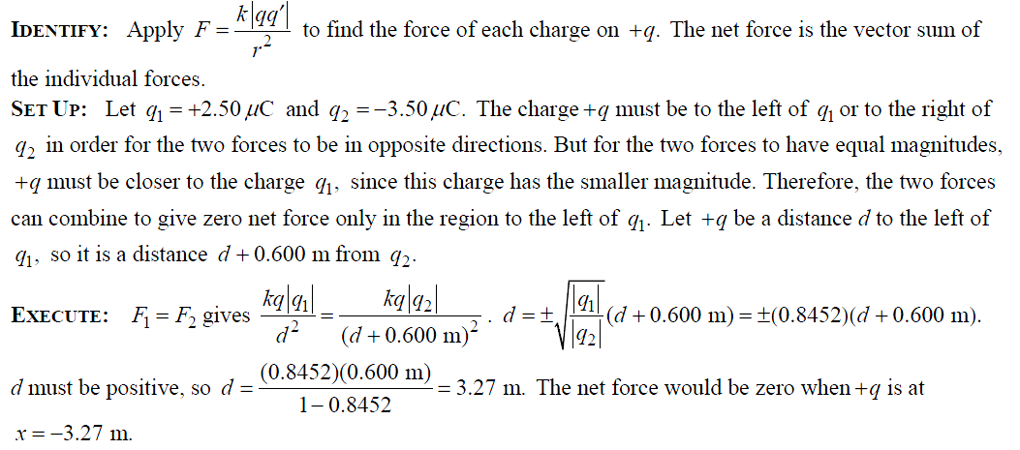

Slide 35



Slide 36


Slide 37
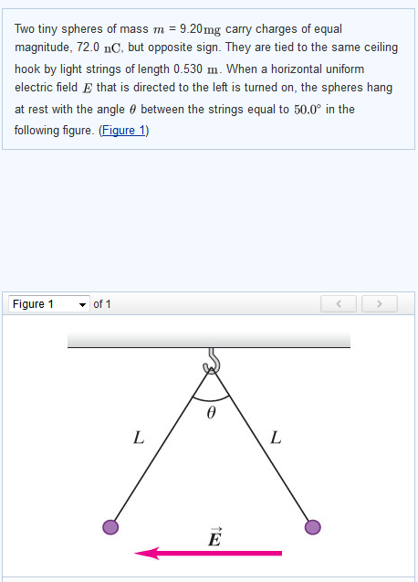

Slide 38


Slide 39
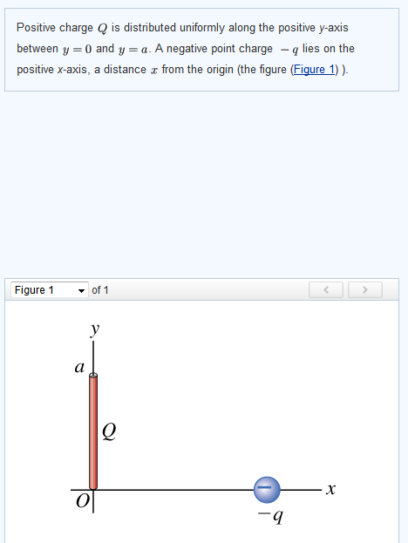



Slide 40
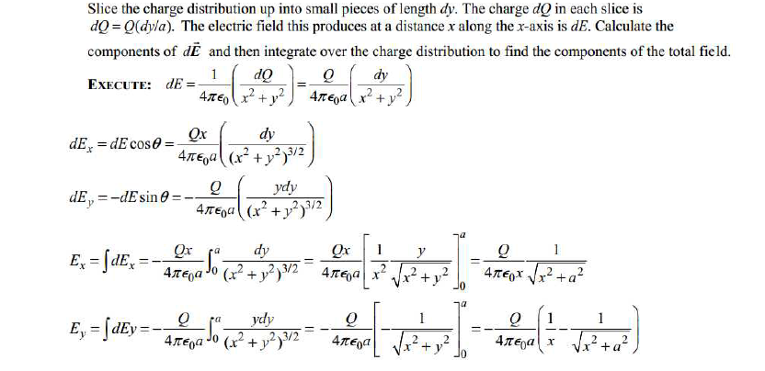

Slide 41



Slide 42


Slide 43
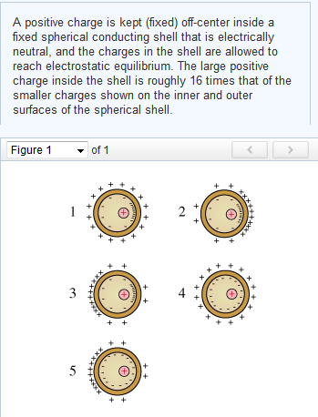

Slide 44


Slide 45
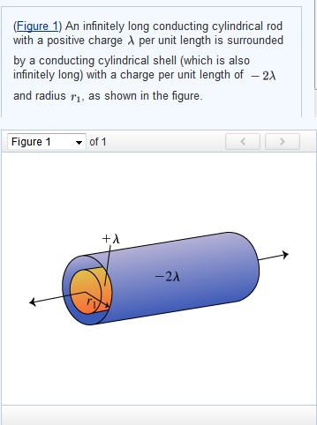


Slide 46


Slide 48


Slide 49


Slide 50


Slide 52


Slide 53
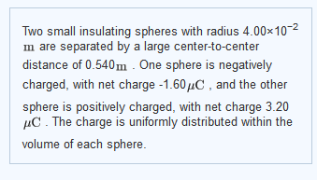


Slide 54
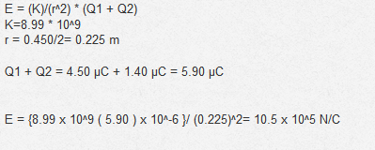



Slide 55
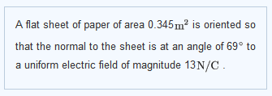


Slide 56



Slide 57



Slide 59
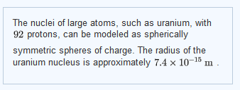


Slide 60


Slide 61
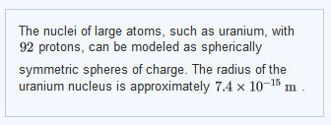


Slide 62


Slide 63


Slide 65



Slide 66


Slide 67
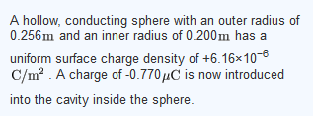

Slide 68


Slide 70


Slide 72


Slide 73
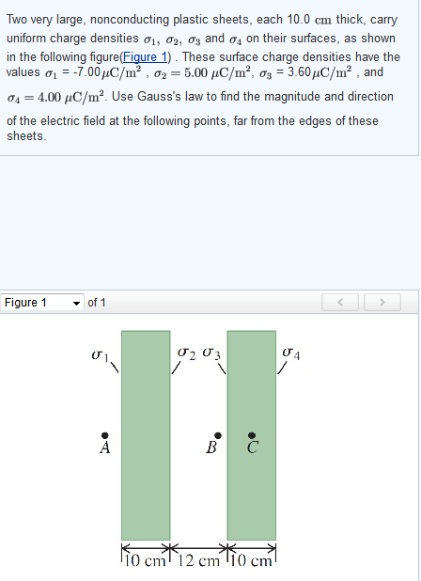


Slide 74

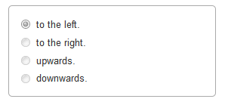

Slide 75


Slide 76



Slide 77


Slide 78

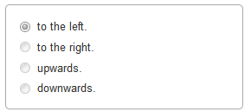

Slide 79
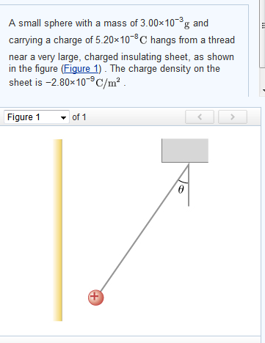

Slide 80
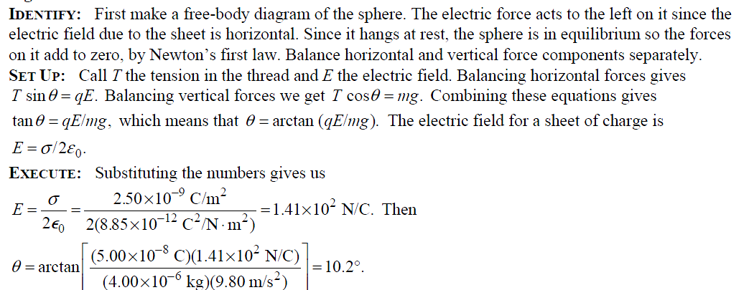

Slide 81
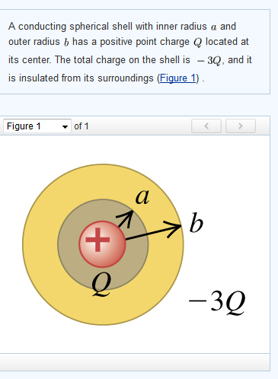


Slide 82



Slide 83


Slide 84


Slide 85


Slide 86



Slide 87


Slide 88


Slide 89


Slide 90


Slide 91
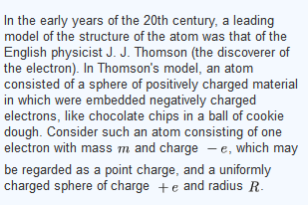



Slide 92



